Slide 1

Operating System
Topic 7: Distributed Operating System
Er. Nawaraj Bhandari

Slide 2
DEFINITION OF A DISTRIBUTED SYSTEM
 A distributed system:
 Multiple connected CPUs working together
 A collection of independent computers that appears to its users as a single coherent system
 Examples: parallel machines, networked machines

Slide 3
ADVANTAGES AND DISADVANTAGES
 Advantages
 Communication and resource sharing possible
 Economics – price-performance ratio
 Reliability, scalability
 Potential for incremental growth
 Disadvantages
 Distribution-aware PLs, OSs and applications
 Network connectivity essential
 Security and privacy

Slide 4
TRANSPARENCY IN A DISTRIBUTED SYSTEM
Transparency | Description
Access | Hide differences in data representation and how a resource is accessed
Location | Hide where a resource is located
Migration | Hide that a resource may move to another location
Relocation | Hide that a resource may be moved to another location while in use
Replication | User cannot tell how many copies exist
Concurrency | Hide that a resource may be shared by several competitive users
Failure | Hide the failure and recovery of a resource
Persistence | Hide whether a (software) resource is in memory or on disk
Different forms of transparency in a distributed system.

Slide 5
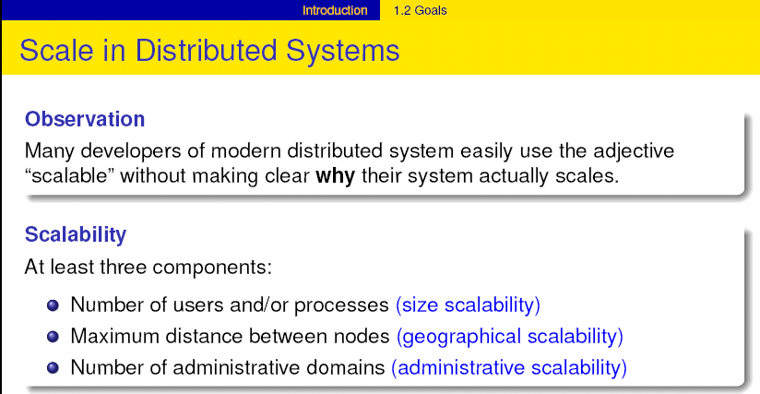

Slide 6

SCALABILITY PROBLEMS
Concept | Example
Centralized services | A single server for all users
Centralized data | A single on-line telephone book
Centralized algorithms | Doing routing based on complete information
Examples of scalability limitations.

Slide 7
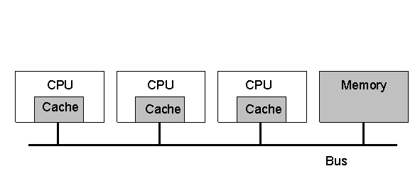
HARDWARE CONCEPTS: MULTIPROCESSORS (1)
 Multiprocessor dimensions
 Memory: could be shared or be private to each CPU
 Interconnect: could be shared (bus-based) or switched
 A bus-based multiprocessor.

Slide 8

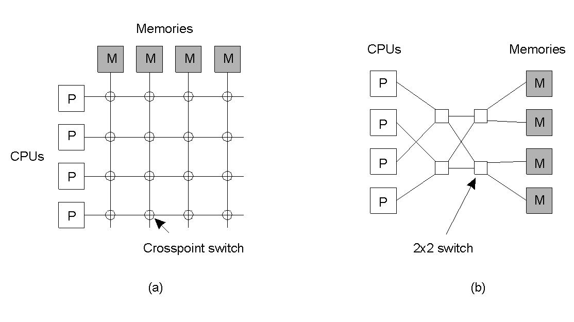
MULTIPROCESSORS (2)
a) A crossbar switch b) An omega switching
network
1.8

Slide 9
DISTRIBUTED SYSTEMS MODELS
 Minicomputer model (e.g., early networks)
 Each user has local machine
 Local processing but can fetch remote data (files, databases)
 Workstation model (e.g., Sprite)
 Processing can also migrate
 Client-server Model (e.g., V system, world wide web)
 User has local workstation
 Powerful workstations serve as servers (file, print, DB servers)
 Processor pool model (e.g., Amoeba, Plan 9)
 Terminals are Xterms or diskless terminals
 Pool of backend processors handle processing

Slide 10
UNIPROCESSOR OPERATING SYSTEMS
 An OS acts as a resource manager or an arbitrator
 Manages CPU, I/O devices, memory
 OS provides a virtual interface that is easier to use
than hardware
 Structure of uniprocessor operating systems
 Monolithic (e.g., MS-DOS, early UNIX)
 One large kernel that handles everything
 Layered design
 Functionality is decomposed into N layers
 Each layer uses services of layer N-1 and implements new service(s) for layer N+1

Slide 11


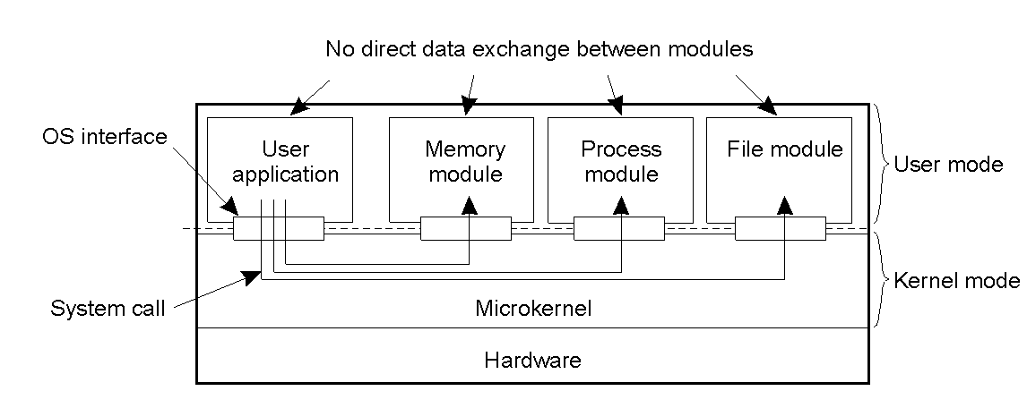
UNIPROCESSOR OPERATING SYSTEMS
Microkernel architecture
Small kernel
user-level servers implement additional functionality

Slide 12
DISTRIBUTED OPERATING SYSTEM
 Manages resources in a distributed system
 Seamlessly and transparently to the user
 Looks to the user like a centralized OS
 But operates on multiple independent CPUs
 Provides transparency
 Location, migration, concurrency, replication,…
 Presents users with a virtual uniprocessor

Slide 13

DOS: CHARACTERISTICS (1)
 Distributed Operating Systems
 Allows a multiprocessor or multicomputer network
resources to be integrated as a single system image
 Hide and manage hardware and software resources
 provides transparency support
 provide heterogeneity support
 control network in most effective way
 consists of low level commands + local operating systems + distributed features
 Inter-process communication (IPC)

Slide 14

DOS: CHARACTERISTICS (2)
 remote file and device access
 global addressing and naming
 trading and naming services
 synchronization and deadlock avoidance
 resource allocation and protection
 global resource sharing
 deadlock avoidance
 communication security
 no examples in general use but many research systems: Amoeba, Chorus etc.

Slide 15

TYPES OF DISTRIBUTED OS
System | Description | Main Goal
DOS | Tightly-coupled operating system for multi- processors and homogeneous multicomputers | Hide and manage hardware resources
NOS | Loosely-coupled operating system for heterogeneous multicomputers (LAN and WAN) | Offer local services to remote clients
Middleware | Additional layer atop of NOS implementing general- purpose services | Provide distribution transparency

Slide 16
MULTIPROCESSOR OPERATING SYSTEMS
 Like a uniprocessor operating system
 Manages multiple CPUs transparently to the user
 Each processor has its own hardware cache
 Maintain consistency of cached data

Slide 17
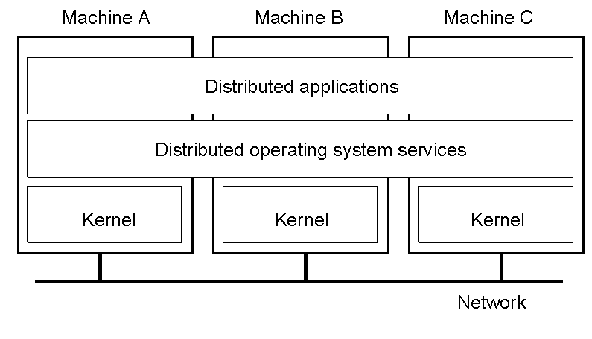
MULTICOMPUTER OPERATING SYSTEMS
1.14

Slide 18
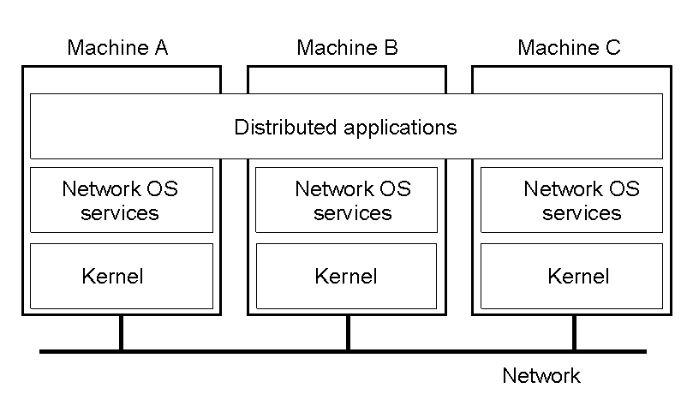
NETWORK OPERATING SYSTEM
1-19

Slide 19
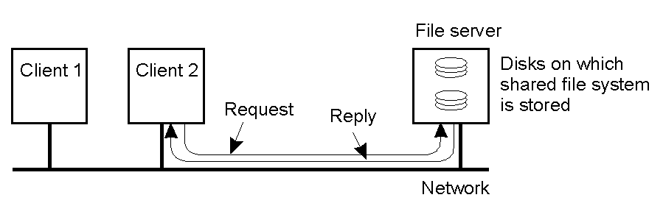
NETWORK OPERATING SYSTEM
 Employs a client-server model
 Minimal OS kernel
 Additional functionality as user processes

Slide 20



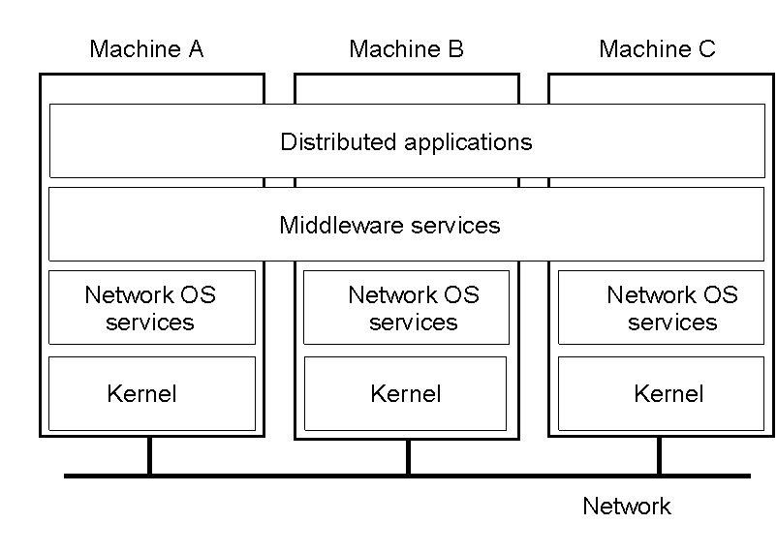
MIDDLEWARE-BASED SYSTEMS
 General structure of a distributed system as middleware.
1-22

Slide 21

MIDDLEWARE EXAMPLES
 Examples: Sun RPC, CORBA, DCOM, Java RMI (distributed object technology)
 Built on top of transport layer in the ISO/OSI 7 layer reference model: application (protocol), presentation (semantic), session (dialogue), transport (e.g. TCP or UDP), network (IP, ATM etc), data link (frames, checksum), physical (bits and bytes)
 Most are implemented over the internet protocols
 Masks heterogeneity of underlying networks, hardware, operating system and programming languages – so provides a uniform programming model with standard services
 3 types of middleware:
 transaction oriented (for distributed database applications)
 message oriented (for reliable asynchronous communication)
 remote procedure calls (RPC) – the original OO middleware

Slide 22
COMPARISON BETWEEN SYSTEMS
Item | Distributed OS |  | Network OS | Middleware- based OS
 | Multiproc. | Multicomp.
Degree of transparency | Very High | High | Low | High
Same OS on all nodes | Yes | Yes | No | No
Number of copies of OS | 1 | N | N | N
Basis for communication | Shared memory | Messages | Files | Model specific
Resource management | Global, central | Global, distributed | Per node | Per node
Scalability | No | Moderately | Yes | Varies
Openness | Closed | Closed | Open | Open

Slide 23
COMMUNICATION IN DISTRIBUTED SYSTEMS
 Issues in communication
 Message-oriented Communication
 Remote Procedure Calls
 Transparency but poor for passing references
 Remote Method Invocation
 RMIs are essentially RPCs but specific to remote objects
 System wide references passed as parameters
 Stream-oriented Communication

Slide 24

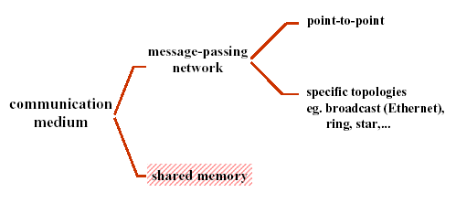
TYPES OF COMMUNICATION
Message passing is the general basis of communication in a distributed system: transferring a set of data from a sender to a receiver.

Slide 25
COMMUNICATION BETWEEN PROCESSES
 Unstructured communication
 Use shared memory or shared data structures
 Structured communication
 Use explicit messages (IPCs)
 Distributed Systems: both need low-level communication support

Slide 26
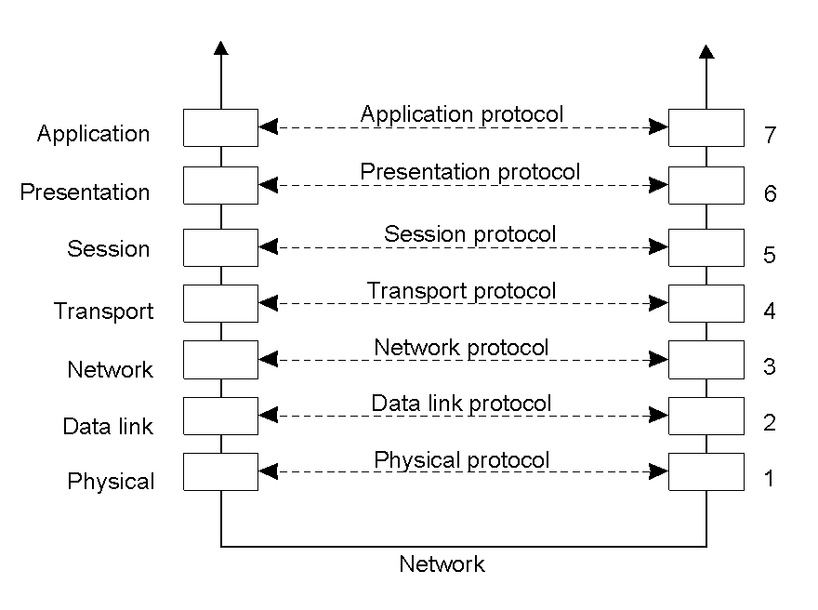
COMMUNICATION PROTOCOLS
 Protocols are agreements/rules on communication
 Protocols could be connection-oriented or connectionless
2-1

Slide 27

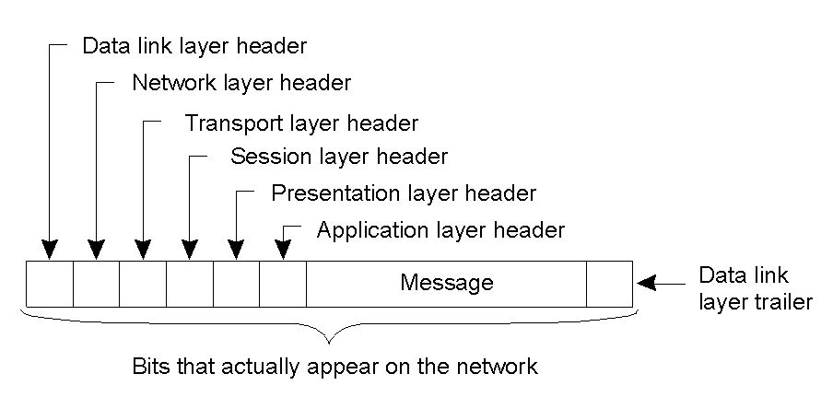
LAYERED PROTOCOLS
 A typical message as it appears on the network.
2-2

Slide 28
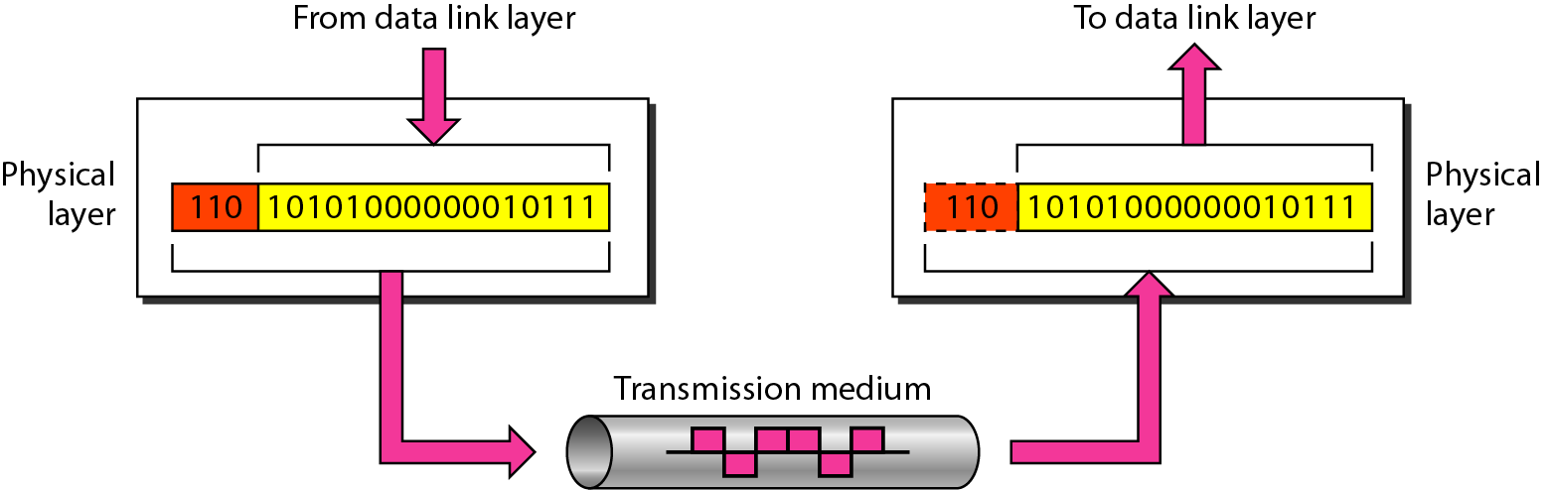
Physical layer
The physical layer is responsible for movements of
individual bits from one hop (node) to the next.

Slide 29

PHYSICAL LAYER
OSI Model
Provides physical interface for transmission of information.
Defines rules by which bits are passed from one system to another on a physical communication medium.
Covers all - mechanical, electrical, functional and procedural - aspects for physical communication.
Such characteristics as voltage levels, timing of voltage changes, physical data rates, maximum transmission distances, physical connectors, and other similar attributes are defined by physical layer specifications.

Slide 30
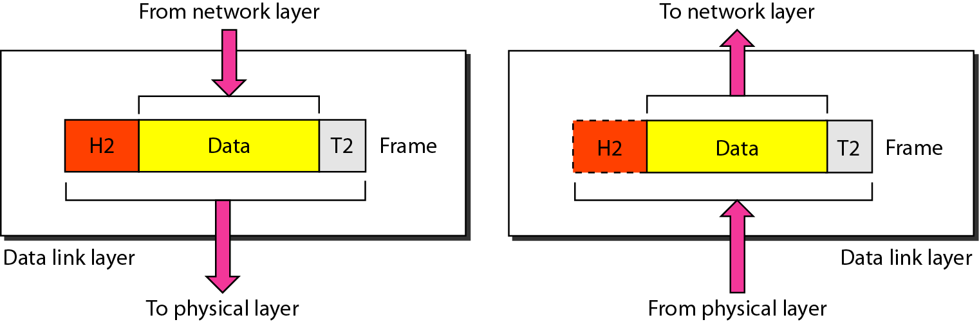
Data link layer
The data link layer is responsible for moving
frames from one hop (node) to the next and perform error detection and correction

Slide 31

DATA LINK LAYER
OSI Model
Data link layer attempts to provide reliable communication over the physical layer interface.
Breaks the outgoing data into frames and reassemble the received frames.
Create and detect frame boundaries.
Handle errors by implementing an acknowledgement and
retransmission scheme.
Implement flow control.
Supports points-to-point as well as broadcast communication.
Supports simplex, half-duplex or full-duplex communication.

Slide 32

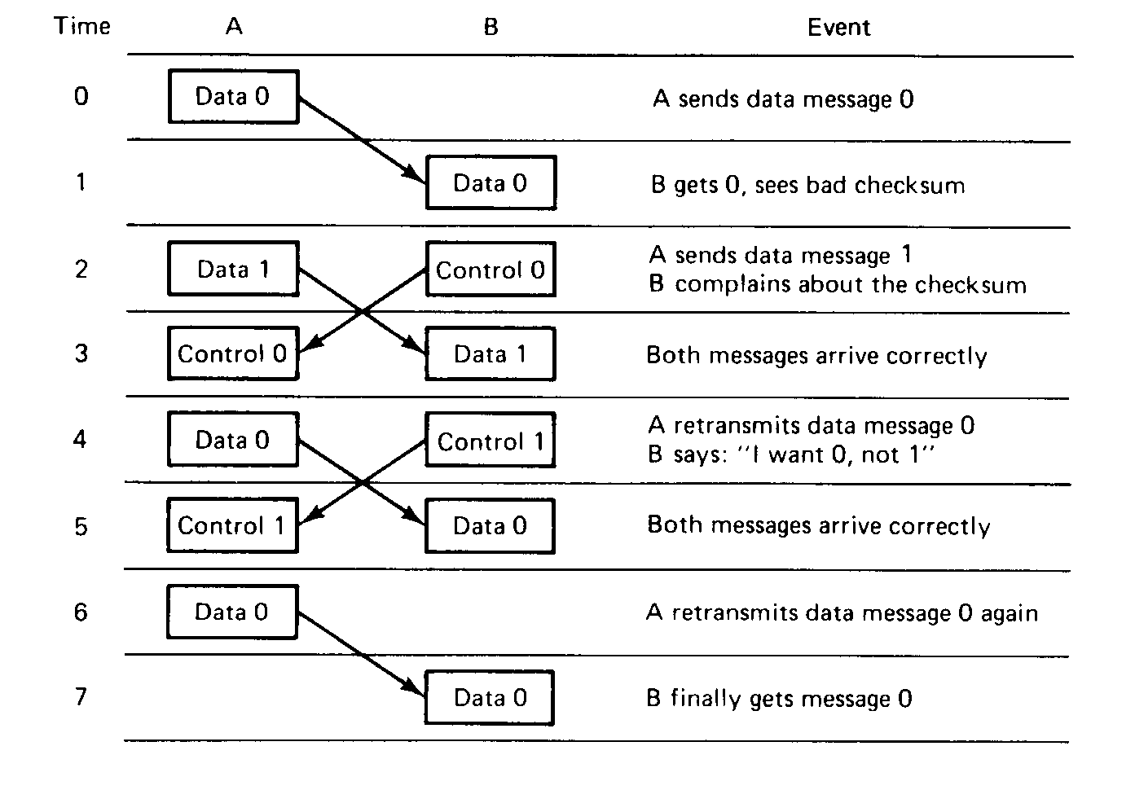
DATA LINK LAYER

Slide 33
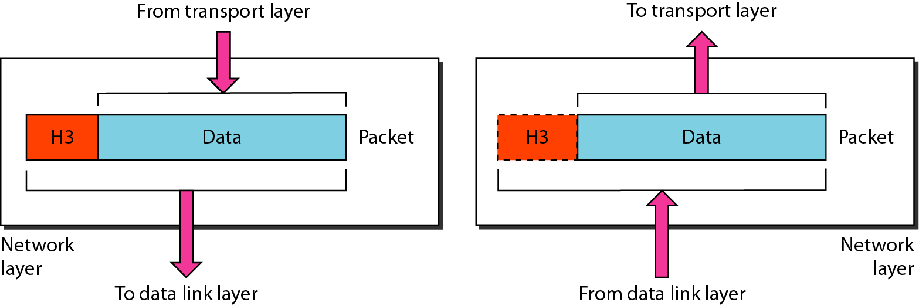
Network layer
The network layer is responsible for the delivery of individual packets from
the source host to the destination host.
Protocols: X.25→Connection oriented IP → Connection Less

Slide 34

NETWORK LAYER
OSI Model
Implements routing of network.
frames (packets) through the
Defines the most optimum path the packet should take from the source to the destination
Defines logical addressing so that any endpoint can be
identified.
Handles congestion in the network.
Facilitates interconnection between heterogeneous networks (Internetworking).
The network layer also defines how to fragment a packet into smaller packets to accommodate different media.

Slide 35
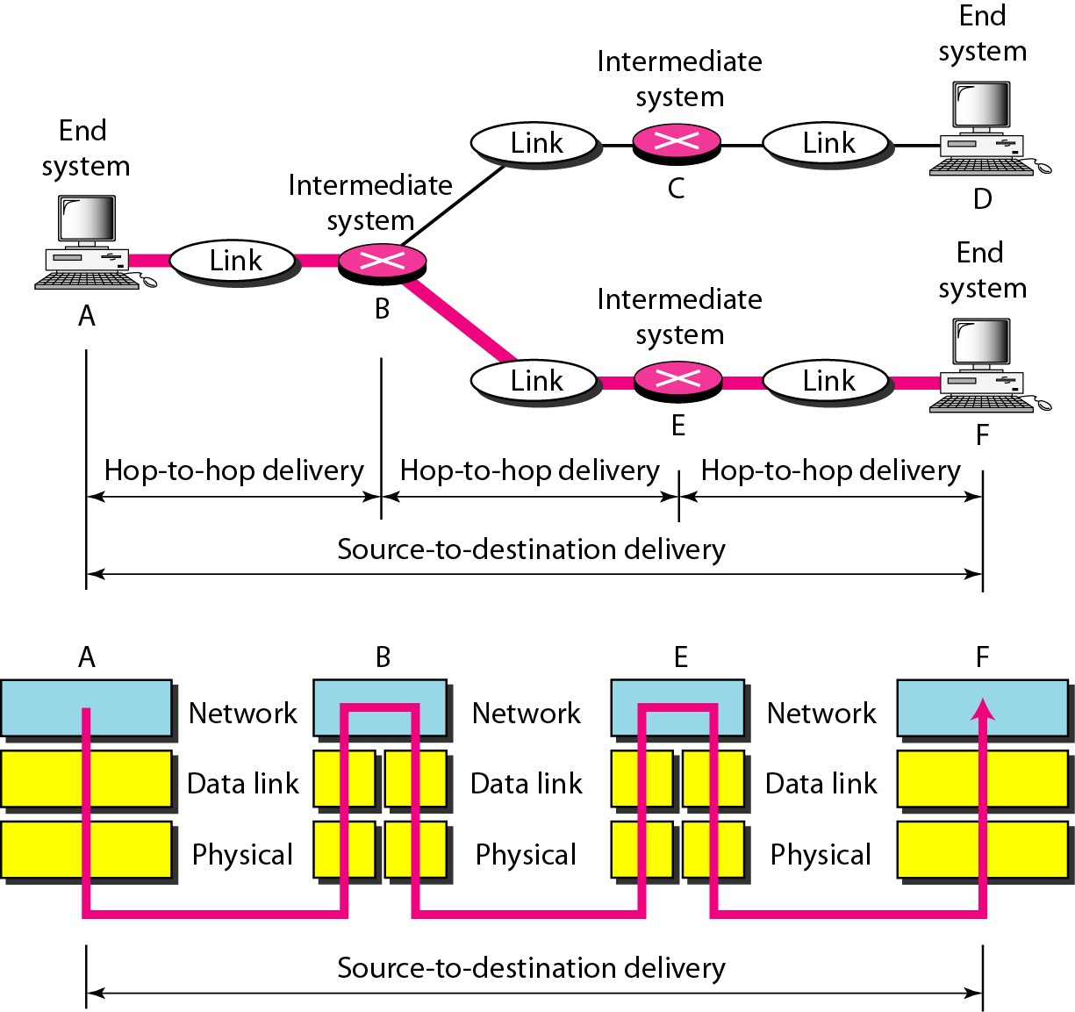
Source-to-destination delivery

Slide 36
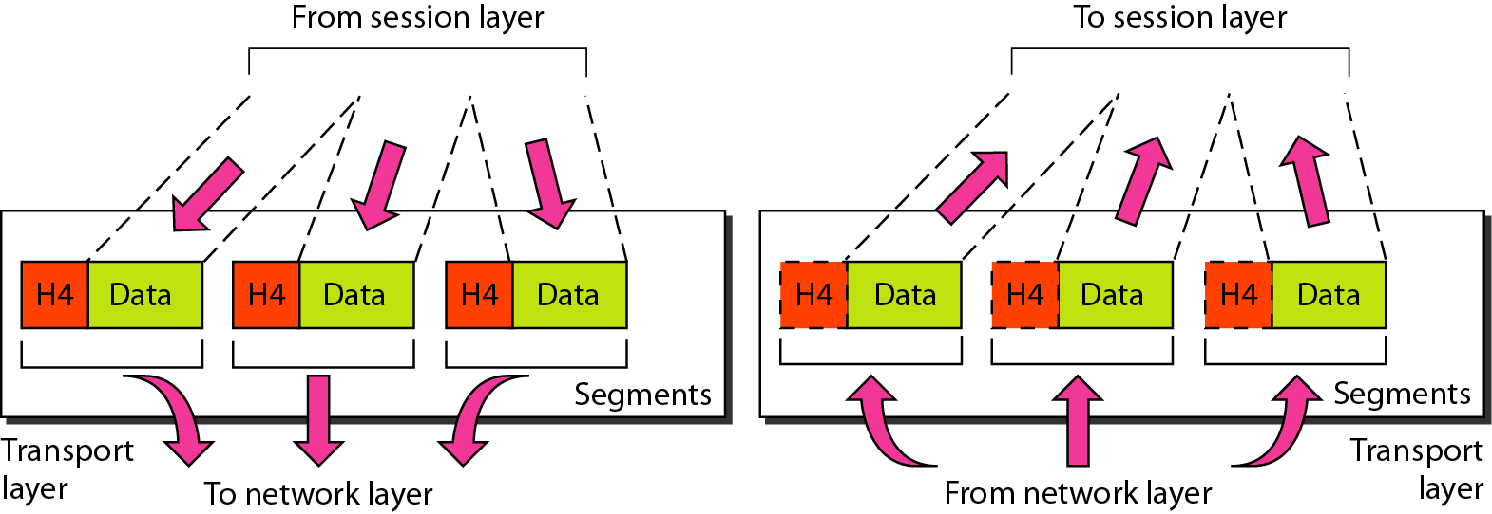
Transport layer
The transport layer is responsible for the delivery of a message from one process to another.
Protocols: TCP →Connection oriented UDP → Connection Less

Slide 37

TRANSPORT LAYER
OSI Model
Purpose of this layer is to provide a reliable mechanism for the exchange of data between two processes in different computers.
Ensures that the data units are delivered error free. Ensures that data units are delivered in sequence.
Ensures that there is no loss or duplication of data units. Provides connectionless or connection oriented service.
Provides for the connection management.
Multiplex multiple connection over a single channel.

Slide 38
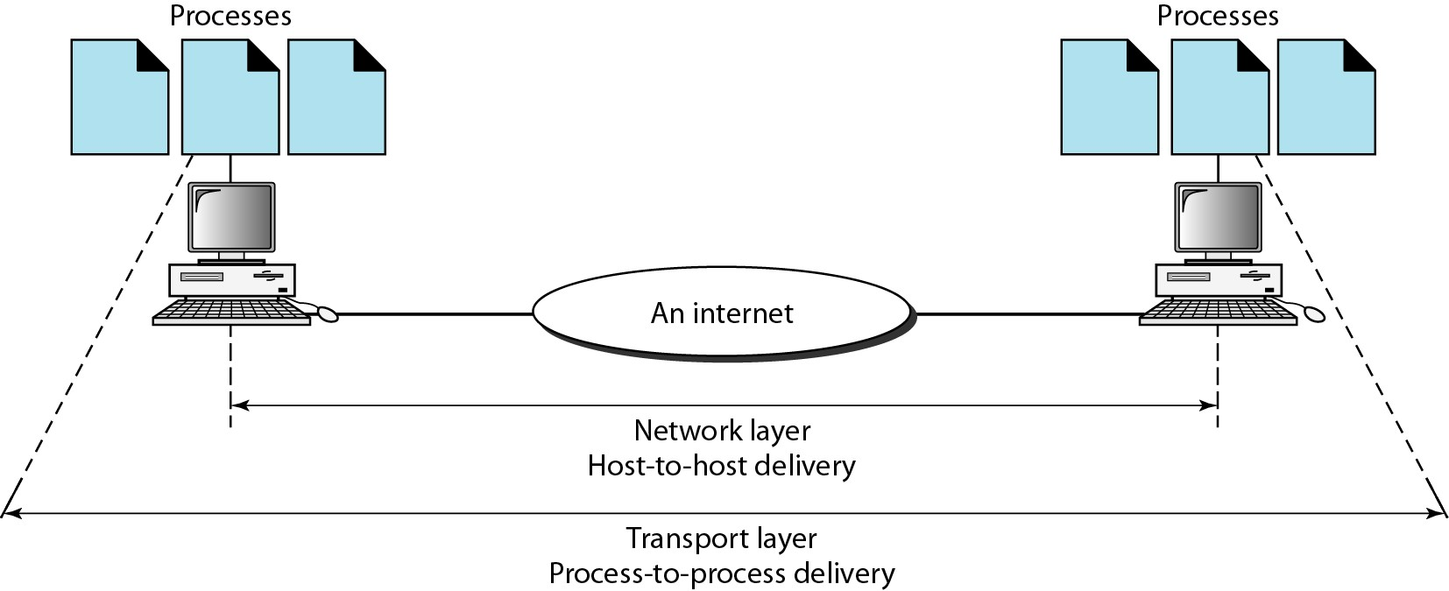
Reliable process-to-process delivery of a message

Slide 39
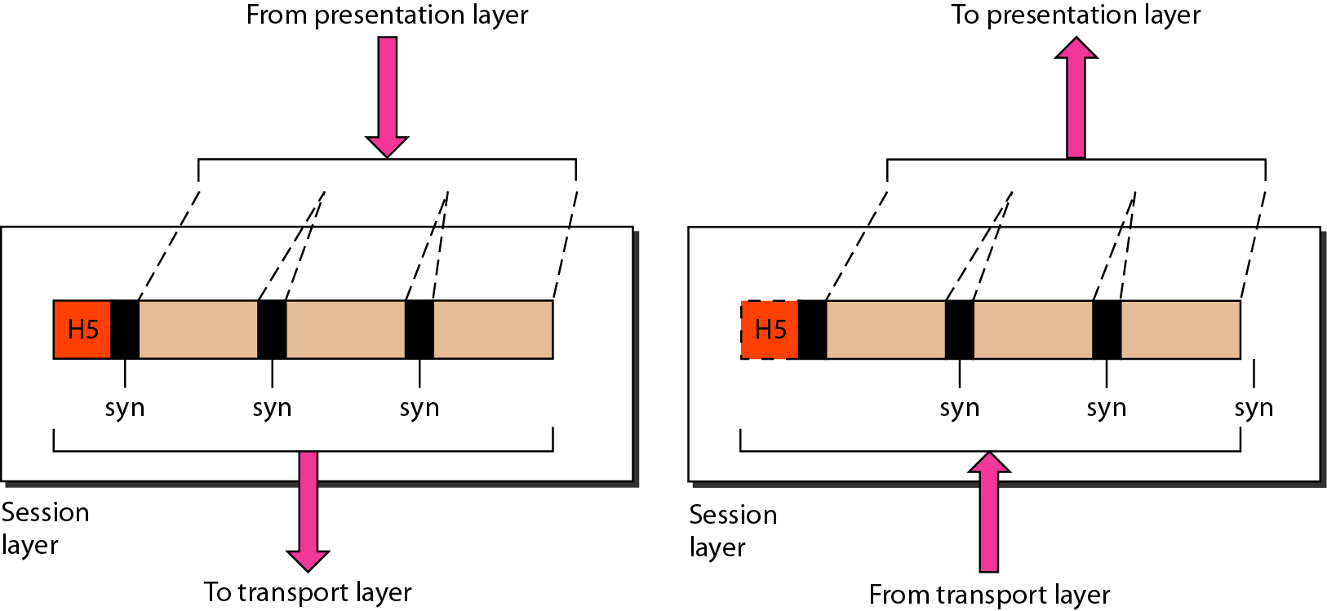
Session layer
The session layer is responsible for dialog control and synchronization.

Slide 40

SESSION LAYER
OSI Model
Session layer provides mechanism for controlling the dialogue between the two end systems. It defines how to start, control and end conversations (called sessions) between applications.
This layer requests for a logical connection to be established on an end-user’s request.
Any necessary log-on or password validation is also handled by
this layer.
Session layer is also responsible for terminating the connection.
This layer provides services like dialogue discipline which can be full duplex or half duplex.
Session layer can also provide check-pointing mechanism such that if a failure of some sort occurs between checkpoints, all data can be retransmitted from the last checkpoint.

Slide 41
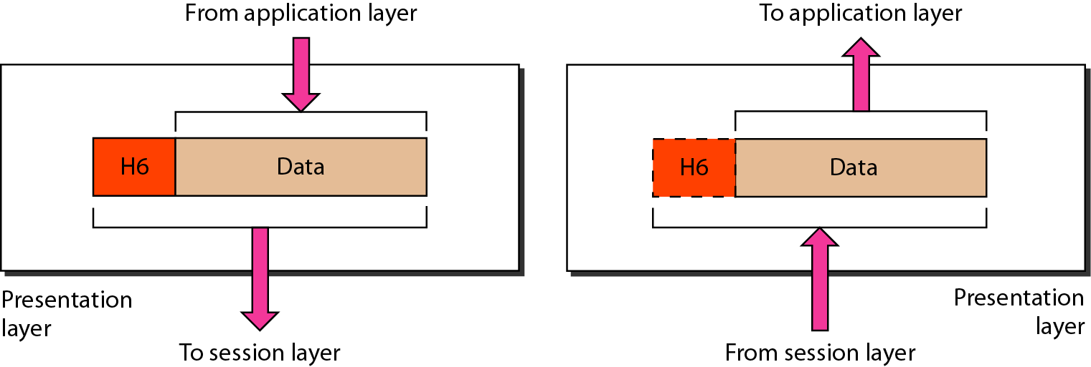
Presentation layer
The presentation layer is responsible for translation, compression, and encryption.

Slide 42

PRESENTATION LAYER
OSI Model
Presentation layer defines the format in which the data is to be exchanged between the two communicating entities.
Also handles data compression and data encryption (cryptography).

Slide 43
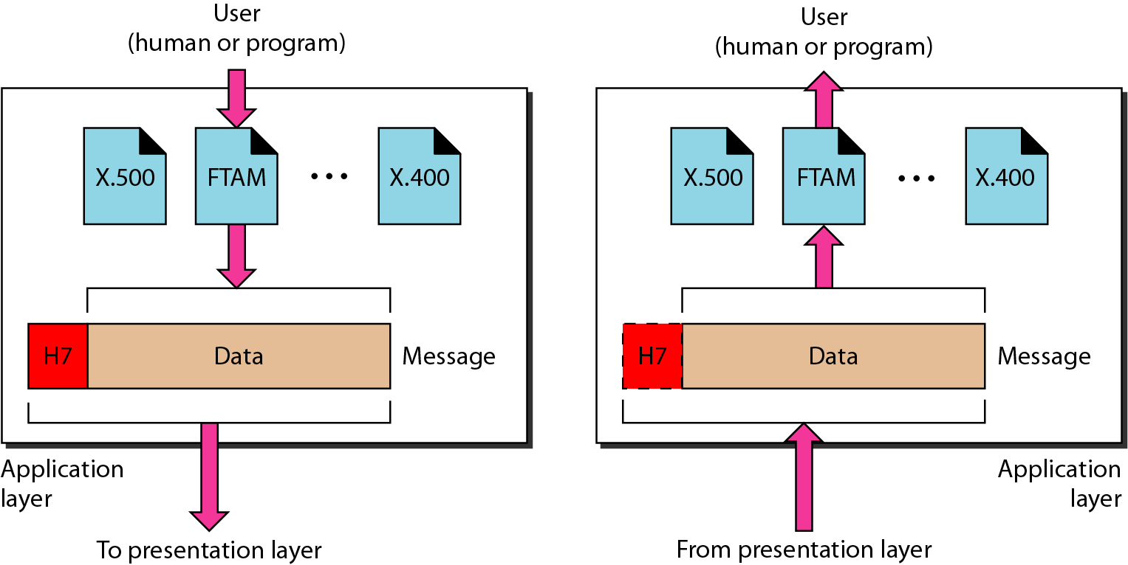
Application layer
The application layer is responsible for providing services to the user.

Slide 44

APPLICATION LAYER
OSI Model
Application layer interacts with application programs and is the highest level of OSI model.
Application layer contains management functions to support distributed applications.
Examples of application layer are applications such as file transfer, electronic mail, remote login etc.

Slide 45
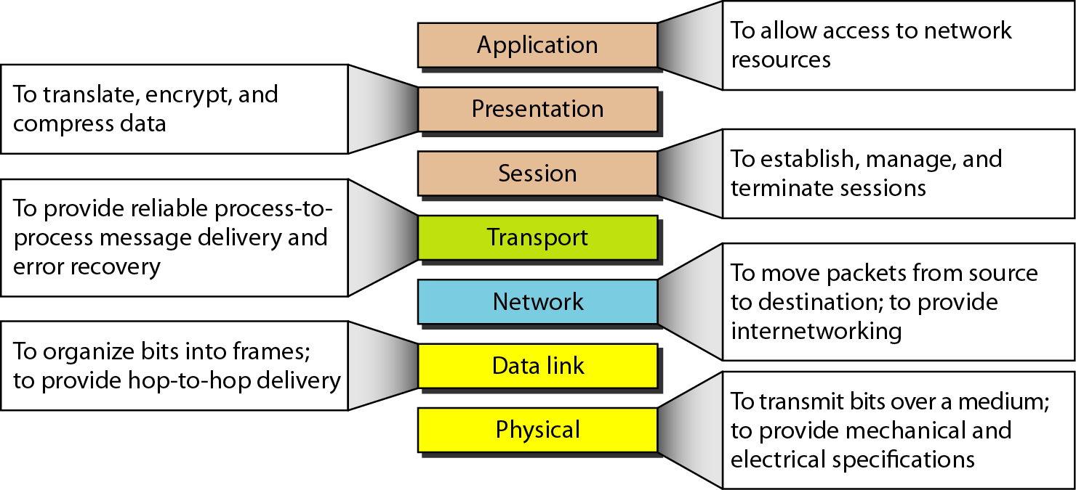
Summary of layers

Slide 46

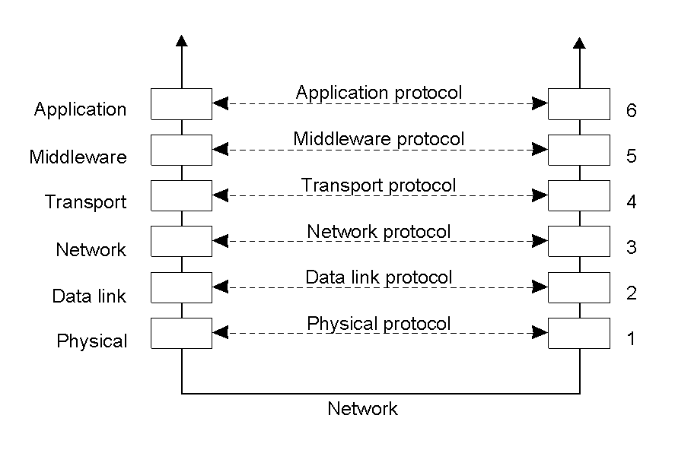
MIDDLEWARE PROTOCOLS
 Middleware: layer that resides between an OS and an application
 May implement general-purpose protocols that warrant their own layers
 Example: distributed commit
2-5

Slide 47

CLIENT-SERVER COMMUNICATION MODEL
 Structure: group of servers offering service to clients
 Based on a request/response paradigm
 Techniques:
 Socket, remote procedure calls (RPC), Remote Method Invocation (RMI)
client
file server
process server
terminal server
kernel
kernel
kernel
kernel

Slide 48


ISSUES IN CLIENT-SERVER COMMUNICATION
 Addressing
 Blocking versus non-blocking
 Buffered versus unbuffered
 Reliable versus unreliable
 Server architecture: concurrent versus sequential
 Scalability

Slide 49

ADDRESSING ISSUES
Question: how is the server located?
Hard-wired address
 Machine address and process address are known a priori
Broadcast-based
 Server chooses address from a sparse address space
 Client broadcasts request
 Can cache response for future
Locate address via name server
user
server
user
server
NS |  |  |  | user |  |  | server

Slide 50
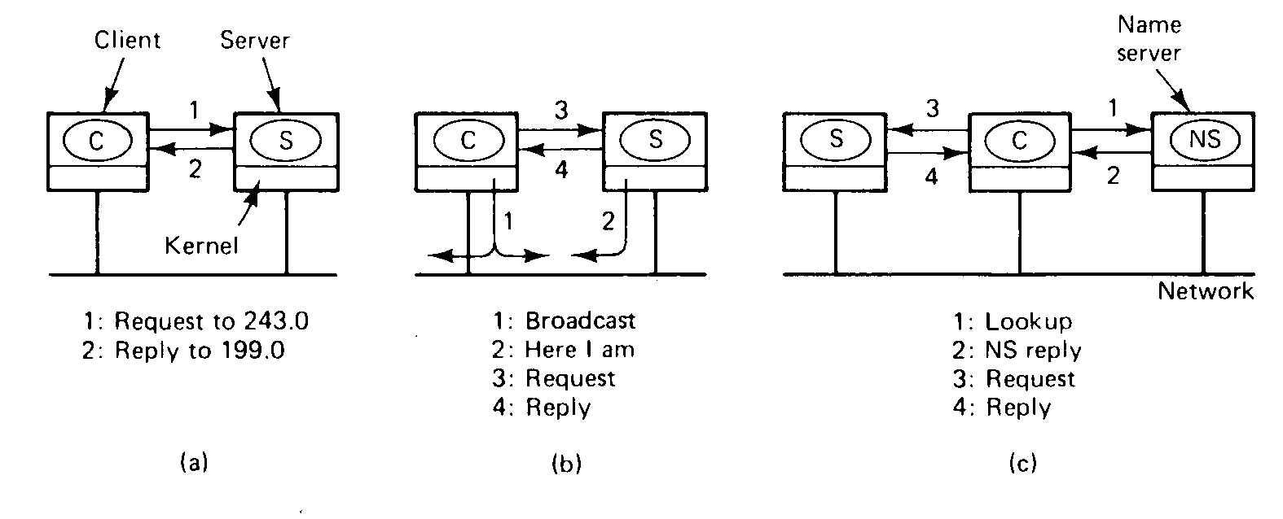

Slide 51


BLOCKING VERSUS NON-BLOCKING
 Blocking communication (synchronous)
 Send blocks until message is actually sent
 Receive blocks until message is actually received
 Non-blocking communication (asynchronous)
 Send returns immediately
 Return does not block either

Slide 52
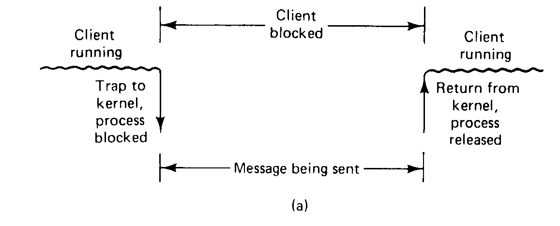

Slide 53
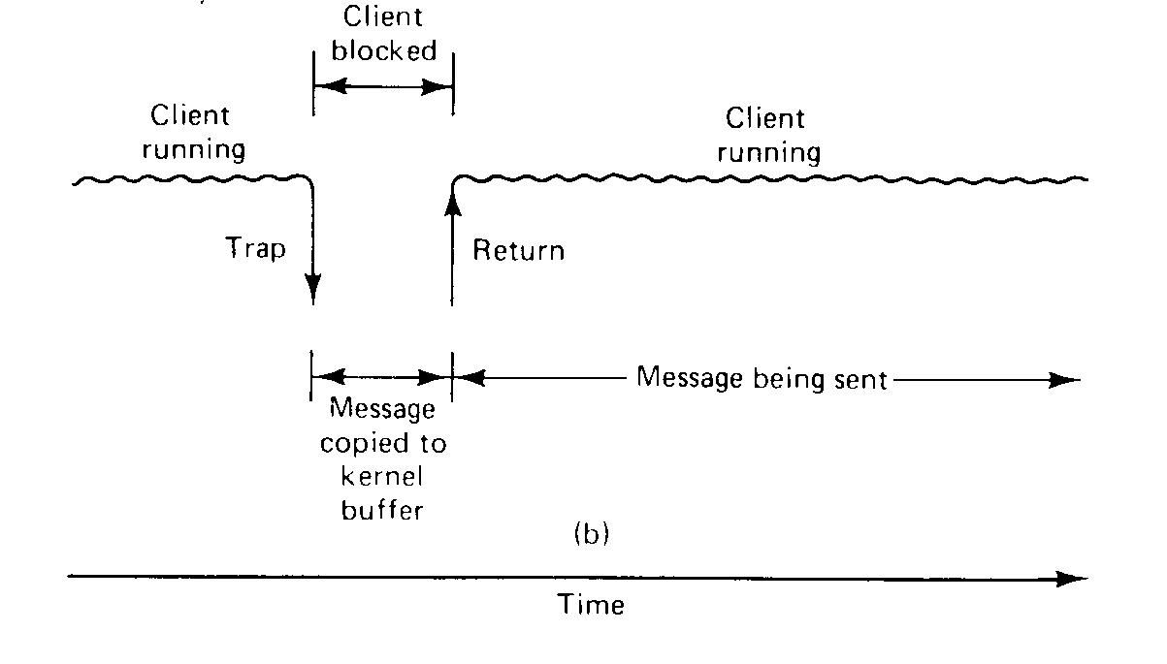

Slide 54

BUFFERING ISSUES
 Unbuffered communication
 Server must call receive before client can call send
user
server
user
server
 Buffered communication
 Client send to a mailbox
 Server receives from a mailbox

Slide 55

RELIABILITY
 Unreliable channel
 Need acknowledgements (ACKs)
 Applications handle ACKs
 ACKs for both request and reply
 Reliable channel
 Reply acts as ACK for request
 Explicit ACK for response
 Reliable communication on unreliable channels
 Transport protocol handles lost
messages
request ACK
reply
ACK
User
Server
request reply
ACK
User
Server

Slide 56
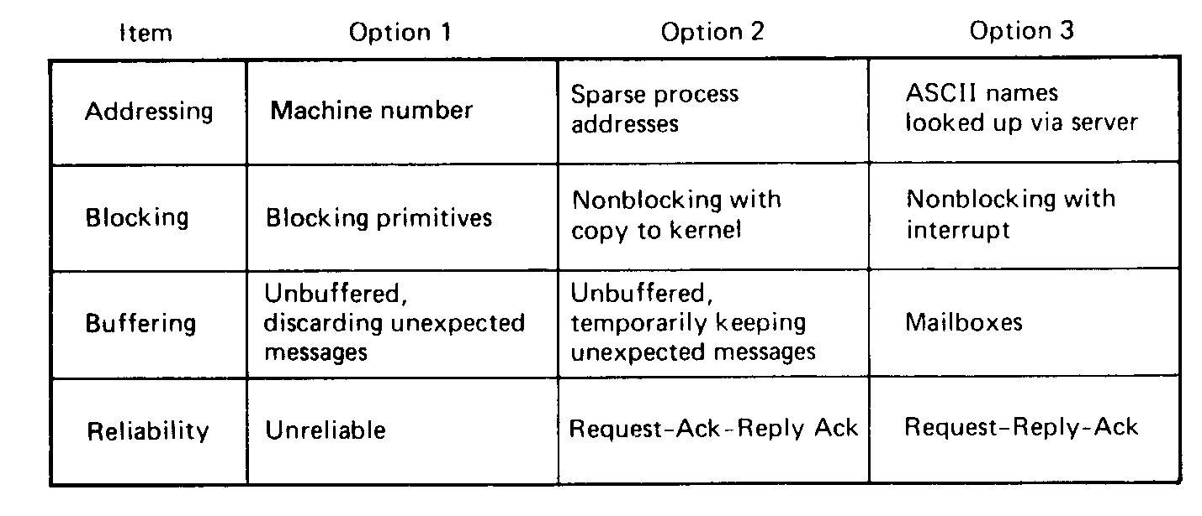

Slide 57

SERVER ARCHITECTURE
 Sequential
 Serve one request at a time
 Can service multiple requests by employing events and
asynchronous communication
 Concurrent
 Server spawns a process or thread to service each request
 Can also use a pre-spawned pool of threads/processes (apache)
 Thus servers could be
 Pure-sequential, event-based, thread-based, process-based
 Discussion: which architecture is most efficient?

Slide 58

SCALABILITY
 Question:How can you scale the server capacity?
 Buy bigger machine!
 Replicate
 Distribute data and/or algorithms
 Ship code instead of data
 Cache

Slide 59





TO PUSH OR PULL ?
 Client-pull architecture
 Clients pull data from servers (by sending requests)
 Example: HTTP
 Pro: stateless servers, failures are each to handle
 Con: limited scalability
 Server-push architecture
 Servers push data to client
 Example: video streaming, stock tickers
 Pro: more scalable, Con: stateful servers, less resilient to failure
 When/how-often to push or pull?

Slide 60

GROUP COMMUNICATION
 One-to-many communication: useful for distributed applications
 Issues:
 Group characteristics:
 Static/dynamic, open/closed
 Group addressing
 Multicast, broadcast, application-level multicast (unicast)
 Atomicity
 Message ordering
 Scalability

Slide 61
PUTTING IT ALL TOGETHER: EMAIL
 User uses mail client to compose a message
 Mail client connects to mail server
 Mail server looks up address to destination mail server
 Mail server sets up a connection and passes the mail to destination mail server
 Destination stores mail in input buffer (user mailbox)
 Recipient checks mail at a later time

Slide 62
EMAIL: DESIGN CONSIDERATIONS
 Structured or unstructured?
 Addressing?
 Blocking/non-blocking?
 Buffered or unbuffered?
 Reliable or unreliable?
 Server architecture
 Scalability
 Push or pull?
 Group communication

Slide 63


REMOTE PROCEDURE CALLS
 Goal: Make distributed computing look like centralized computing
 Allow remote services to be called as procedures
 Transparency with regard to location, implementation, language
 Issues
 How to pass parameters
 Bindings
 Semantics in face of errors
 Two classes: integrated into prog, language and separate

Slide 64
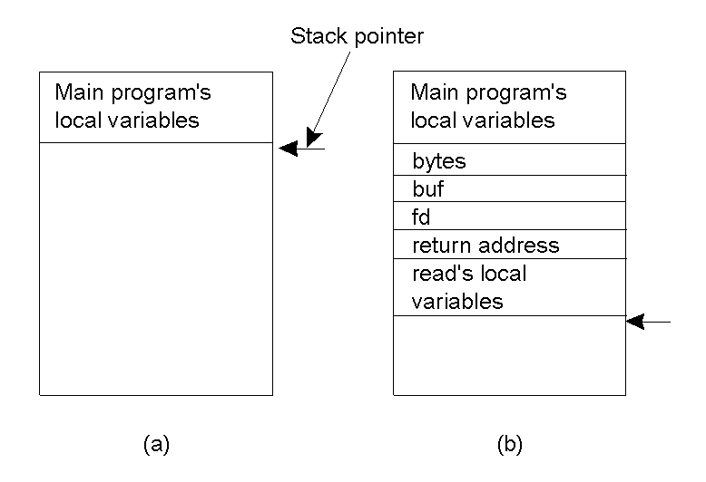
CONVENTIONAL PROCEDURE CALL
a)
Parameter passing in a local procedure call: the stack before the call to read
b) The stack while the called procedure is active

Slide 65

PARAMETER PASSING
 Local procedure parameter passing
 Call-by-value
 Call-by-reference: arrays, complex data structures
 Remote procedure calls simulate this through:
 Stubs – proxies
 Flattening – marshalling
 Related issue: global variables are not allowed in RPCs

Slide 66

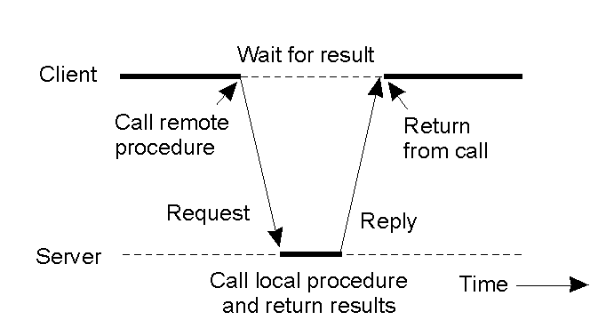
CLIENT AND SERVER STUBS
 Principle of RPC between a client and server program.

Slide 67

STUBS
 Client makes procedure call (just like a local procedure call) to the client stub
 Server is written as a standard procedure
 Stubs take care of packaging arguments and sending messages
 Packaging parameters is called marshalling
 Stub compiler generates stub automatically from specs in an Interface Definition Language (IDL)
 Simplifies programmer task

Slide 68
STEPS OF A REMOTE PROCEDURE CALL
Client procedure calls client stub in normal way
Client stub builds message, calls local OS
Client's OS sends message to remote OS
Remote OS gives message to server stub
Server stub unpacks parameters, calls server
Server does work, returns result to the stub
Server stub packs it in message, calls local OS
Server's OS sends message to client's OS
Client's OS gives message to client stub
Stub unpacks result, returns to client

Slide 69

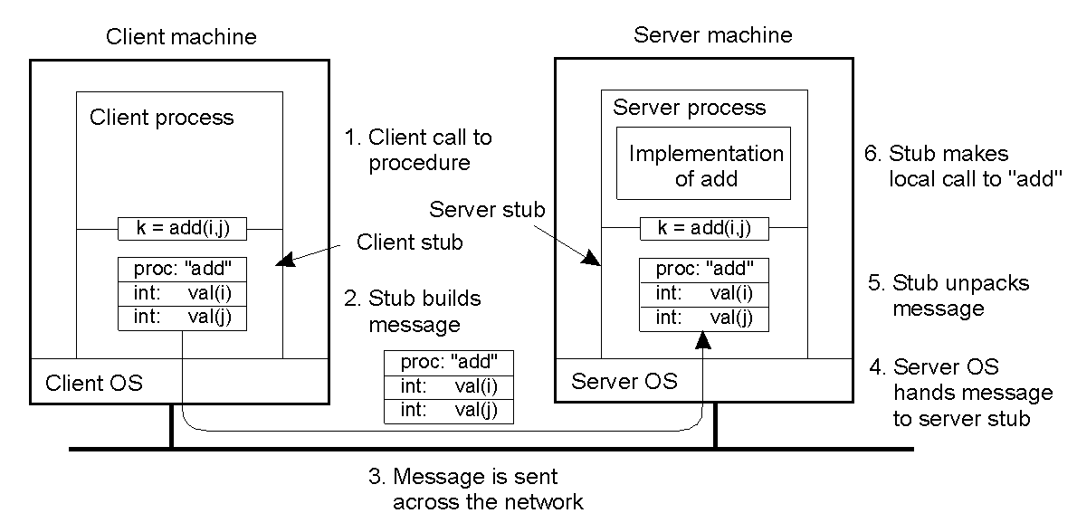
EXAMPLE OF AN RPC
2-8

Slide 70

MARSHALLING
 Problem: different machines have different data formats
 Intel: little endian, SPARC: big endian
 Solution: use a standard representation
 Example: external data representation (XDR)
 Problem: how do we pass pointers?
 If it points to a well-defined data structure, pass a copy and the server
stub passes a pointer to the local copy
 What about data structures containing pointers?
 Prohibit
 Chase pointers over network
 Marshalling: transform parameters/results into a byte stream

Slide 71

BINDING
 Problem: how does a client locate a server?
 Use Bindings
 Server
 Export server interface during initialization
 Send name, version no, unique identifier, handle (address) to binder
 Client
 First RPC: send message to binder to import server interface
 Binder: check to see if server has exported interface
 Return handle and unique identifier to client

Slide 72

BINDING: COMMENTS
 Exporting and importing incurs overheads
 Binder can be a bottleneck
 Use multiple binders
 Binder can do load balancing

Slide 73

FAILURE SEMANTICS
 Client unable to locate server: return error
 Lost request messages: simple timeout mechanisms
 Lost replies: timeout mechanisms
 Make operation idempotent
 Use sequence numbers, mark retransmissions
 Server failures: did failure occur before or after operation?
 At least once semantics (SUNRPC)
 At most once
 No guarantee
 Exactly once: desirable but difficult to achieve

Slide 74
FAILURE SEMANTICS
 Client failure: what happens to the server computation?
 Referred to as an orphan
 Extermination: log at client stub and explicitly kill orphans
 Overhead of maintaining disk logs
 Reincarnation: Divide time into epochs between failures and delete computations from old epochs
 Gentle reincarnation: upon a new epoch broadcast, try to locate owner first (delete only if no owner)
 Expiration: give each RPC a fixed quantum T; explicitly
request extensions
 Periodic checks with client during long computations

Slide 75

IMPLEMENTATION ISSUES
 Choice of protocol [affects communication costs]
 Use existing protocol (UDP) or design from scratch
 Packet size restrictions
 Reliability in case of multiple packet messages
 Flow control
 Copying costs are dominant overheads
 Need at least 2 copies per message
 From client to NIC and from server NIC to server
 As many as 7 copies
 Stack in stub – message buffer in stub – kernel – NIC – medium –
NIC – kernel – stub – server
 Scatter-gather operations can reduce overheads

Slide 76

CASE STUDY: SUNRPC
 One of the most widely used RPC systems
 Developed for use with NFS
 Built on top of UDP or TCP
 TCP: stream is divided into records
 UDP: max packet size < 8912 bytes
 UDP: timeout plus limited number of retransmissions
 TCP: return error if connection is terminated by server
 Multiple arguments marshaled into a single structure
 At-least-once semantics if reply received, at-least-zero semantics if no reply. With UDP tries at-most-once
 Use SUN’s eXternal Data Representation (XDR)
 Big endian order for 32 bit integers, handle arbitrarily large data structures

Slide 77

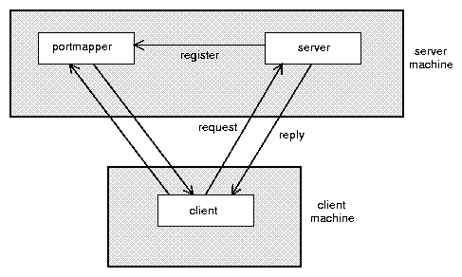
BINDER: PORT MAPPER
Server start-up: create port
Server stub calls svc_register to register prog. #, version # with local port mapper
Port mapper stores prog #, version #, and port
Client start-up: call clnt_create to locate server port
Upon return, client can call procedures at the server

Slide 78


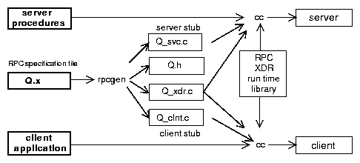
RPCGEN: GENERATING STUBS
 Q_xdr.c: do XDR conversion
 Detailed example: later in this course

Slide 79

SUMMARY
 RPCs make distributed computations look like local computations
 Issues:
 Parameter passing
 Binding
 Failure handling
 Case Study: SUN RPC

